Slide 1
Programming Language II CSE-215
Prof. Dr. Mohammad Abu Yousuf
yousuf@juniv.edu

Slide 2
Class and Object

Slide 3
Object:
Any entity that has state and behavior is known as an object. For example a chair, pen, table, keyboard, bike, etc. It can be physical or logical.
An Object can be defined as an instance of a class. An object contains an address and takes up some space in memory. Objects can communicate without knowing the details of each other's data or code. The only necessary thing is the type of message accepted and the type of response returned by the objects.
Example: A dog is an object because it has states like color, name, breed, etc. as well as behaviors like wagging the tail, barking, eating, etc.

Slide 4
Class:
Collection of objects is called class. It is a logical entity.
A class can also be defined as a blueprint from which you can create an individual object. Class doesn't consume any space.

Slide 5


Class declaration
A class is a template for manufacturing objects. You declare a class by specifying the class keyword followed by a non-reserved identifier that names it. A pair of matching open and close brace characters ({ and }) follow and delimit the class's body.
A class's body is populated with fields, methods, and constructors. Combining these language features into classes is known as encapsulation.

Slide 6
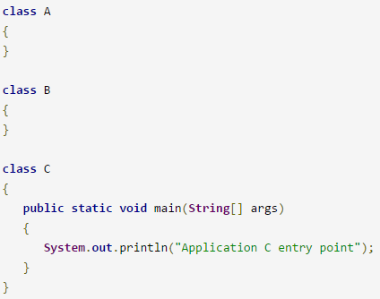
Multi-class applications and main()
A Java application is implemented by one or more classes. Small applications can be accommodated by a single class, but larger applications often require multiple classes. In that case one of the classes is designated as the main class and contains the main() entry-point method.

Slide 7
Object in Java
An entity that has state and behavior is known as an object e.g. chair, bike, marker, pen, table, car etc. It can be physical or logical.
An object has three characteristics:
state: represents data (value) of an object.
behavior: represents the behavior (functionality) of an object such as deposit, withdraw etc.
identity: Object identity is typically implemented via a unique ID.
Object is an instance of a class. Class is a template or blueprint from which objects are created. So object is the instance(result) of a class.

Slide 8

A Simple Class
As stated, a class defines a new type of data. In this case, the new data type is called Box. will use this name to declare objects of type Box. It is important to remember that a class declaration only creates a template; it does not create an actual object.
To actually create a Box object, you will use a statement like the following:
Box mybox = new Box(); // create a Box object called mybox
The new keyword is used to allocate memory at runtime

Slide 9
A Simple Class
each time you create an instance of a class, you are creating an object that contains its own copy of each instance variable defined by the class. Thus, every Box object will contain its own copies of the instance variables width, height, and depth.
To access these variables, you will use the dot (.) operator. The dot operator links the name of the object with the name of an instance variable.
For example, mybox.width = 100;

Slide 10
Declaring Objects
you must acquire an actual, physical copy of the object and assign it to that variable.
You can do this using the new operator. The new operator dynamically allocates (that is, allocates at run time) memory for an object and returns a reference to it.
This reference is, more or less, the address in memory of the object allocated by new. This reference is then stored in the variable. Thus, in Java, all class objects must be dynamically allocated.

Slide 11
Declaring Objects
To declare an object of type Box:
Box mybox = new Box();
This statement combines the two steps just described. It can be rewritten like this to show each step more clearly:
Box mybox; // declare reference to object
mybox = new Box(); // allocate a Box object

Slide 12
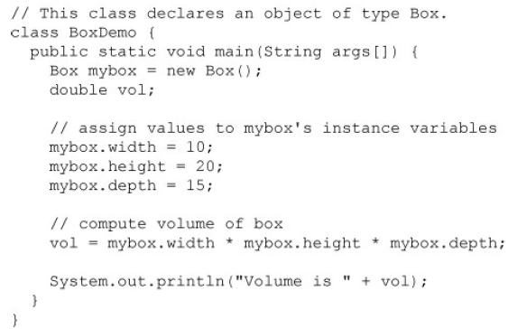
Here is a complete program that uses the Box class

Slide 13
Simple Example of Object and Class
class Student{
//defining fields
int id;//field or data member or instance variable
String name;
//creating main method inside the Student class
public static void main(String args[]){
//Creating an object or instance
Student s1=new Student();//creating an object of Student
//Printing values of the object
System.out.println(s1.id);//accessing member through reference variable
System.out.println(s1.name);
}
}
Output:
0
null
The new keyword is used to allocate memory at runtime

Slide 14
Java Program to demonstrate having the main method in another class
class Student{
int id;
String name;
}
//Creating another class TestStudent1 which contains the main method
class TestStudent1{
public static void main(String args[]){
Student s1=new Student();
System.out.println(s1.id);
System.out.println(s1.name);
}
}
It is a better approach than previous one.

Slide 15
3 Ways to initialize object
There are 3 ways to initialize object in java.
By reference variable
By method
By constructor

Slide 16
3 Ways to initialize object Initialization through reference
class Student{
int id;
String name;
}
class TestStudent3{
public static void main(String args[]){
//Creating objects
Student s1=new Student();
Student s2=new Student();
//Initializing objects
s1.id=101;
s1.name=“Rahim";
s2.id=102;
s2.name=“Samia";
//Printing data
System.out.println(s1.id+" "+s1.name);
System.out.println(s2.id+" "+s2.name);
}
}
Output:
101 Rahim
102 Samia

Slide 17
3 Ways to initialize object Initialization through method
class Student{
int rollno;
String name;
void insertRecord(int r, String n){
rollno=r;
name=n;
}
void displayInformation(){System.out.println(rollno+" "+name);}
}
class TestStudent4{
public static void main(String args[]){
Student s1=new Student();
Student s2=new Student();
s1.insertRecord(101,“Rahim");
s2.insertRecord(102,“Samia");
s1.displayInformation();
s2.displayInformation();
}
}
Output:
101 Rahim
102 Samia

Slide 18
3 Ways to initialize object Initialization through constructor
class Employee{
int id;
String name;
float salary;
Employee (int i, String n, float s) {
id=i;
name=n;
salary=s;
}
void display(){System.out.println(id+" "+name+" "+salary);}
}
public class TestEmployee {
public static void main(String[] args) {
Employee e1=new Employee(101,“Rahim",45000);
Employee e2=new Employee(102,“Samia",25000);
Employee e3=new Employee(103,“Karim",55000);
e1.display();
e2.display();
e3.display();
}
}

Slide 19
Creating multiple objects by one type only
Each object has its own copies of the instance variables. This means that if you have two Box objects, each has its own copy of depth, width, and height.
It is important to understand that changes to the instance variables of one object have no effect on the instance variables of another.

Slide 20
Creating multiple objects by one type only
class Rectangle{
int length;
int width;
void insert(int l, int w){
length=l;
width=w;
}
void calculateArea(){System.out.println(length*width);}
}
class TestRectangle1{
public static void main(String args[]){
Rectangle r1=new Rectangle();
Rectangle r2=new Rectangle();
r1.insert(11,5);
r2.insert(3,15);
r1.calculateArea();
r2.calculateArea();
}
}
Output:
55
45

Slide 21
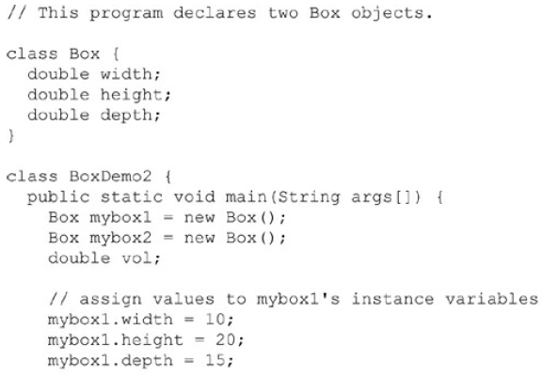
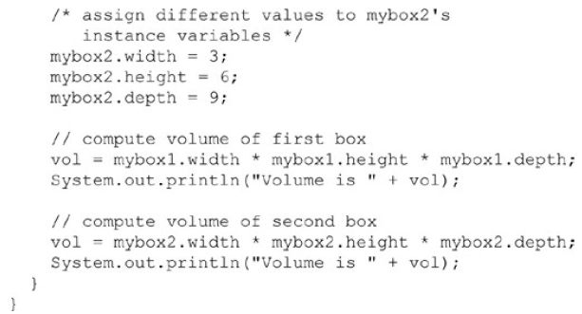
Creating multiple objects by one type only

Slide 22
Assigning Object Reference Variables
Box b1 = new Box();
Box b2 = b1;
You might think that b2 is being assigned a reference to a copy of the object referred to by b1. That is, you might think that b1 and b2 refer to separate and distinct objects.
However, this would be wrong. Instead, after this fragment executes, b1 and b2 will both refer to the same object.
The assignment of b1 to b2 did not allocate any memory or copy any part of the original object. It simply makes b2 refer to the same object as does b1. Thus, any changes made to the object through b2 will affect the object to which b1 is referring, since they are the same object.

Slide 23
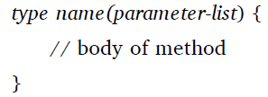
Introducing Methods
The general form of a method:
Here, type specifies the type of data returned by the method. This can be any valid type, including class types that you create. If the method does not return a value, its return type must be void. The name of the method is specified by name.
The parameter-list is a sequence of type and identifier pairs separated by commas.

Slide 24
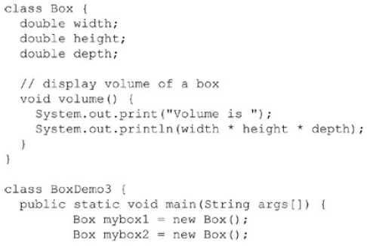
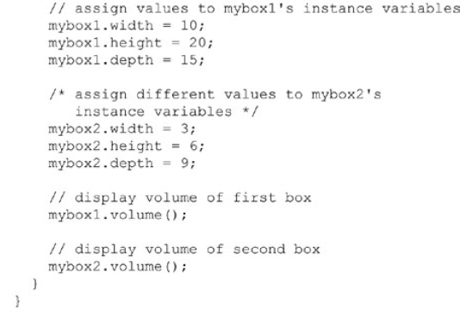
Volume method does not return a value

Slide 25
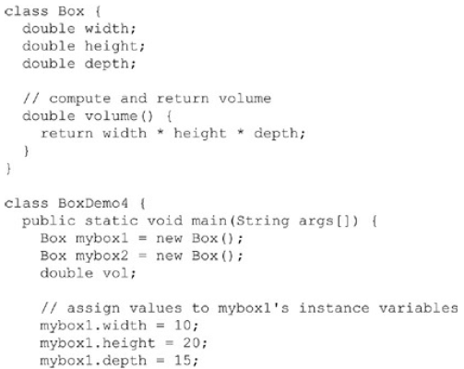
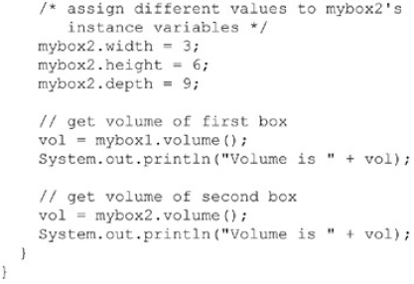
Volume method returns a value

Slide 26
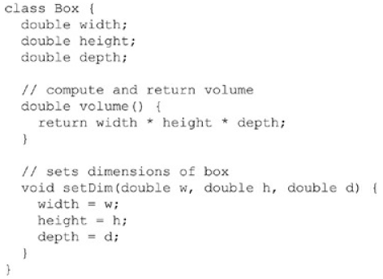
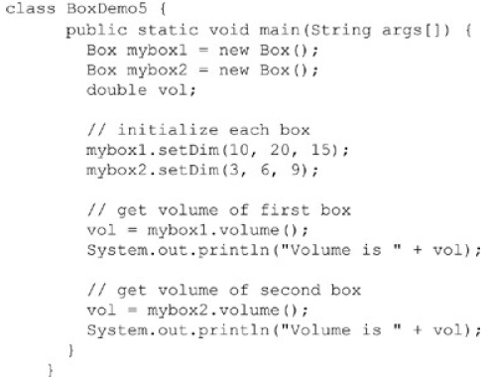
Adding a method that takes parameters

Slide 27
Method Overloading in Java
If a class has multiple methods having same name but different in parameters, it is known as Method Overloading.
If we have to perform only one operation, having same name of the methods increases the readability of the program.

Slide 28
Different ways to overload the method
There are two ways to overload the method in java
By changing number of arguments
By changing the data type

Slide 29
1) Method Overloading: changing no. of arguments
class Adder{
static int add(int a,int b)
{return a+b;}
static int add(int a,int b,int c)
{return a+b+c;}
}
class TestOverloading1{
public static void main(String[] args){
System.out.println(Adder.add(11,11));
System.out.println(Adder.add(11,11,11));
}
}
Output:
22
33

Slide 30
2) Method Overloading: changing data type of arguments
class Adder{
static int add(int a, int b)
{return a+b;}
static double add(double a, double b)
{return a+b;}
}
class TestOverloading2{
public static void main(String[] args){
System.out.println(Adder.add(11,11));
System.out.println(Adder.add(12.3,12.6));
}}

Slide 31
Thank you

